Slide 1
Using SLO Reporting to identify equity gaps
Student Learning Outcomes Assessment Council
Logan Wood Assessment Coordinator
Image credit: http://assessmentcommons.org

Slide 2
Erik Bruce
Social and Behavioral Sciences
Early Childhood Education
Kinesiology, Health Ed and PE
Math
Alex Jones
Career Technical Education
Allied Health
Nursing
World Languages
Logan Wood (Committee Chair, Assessment Coordinator)
Fine and Performing Arts, English/Humanities
ESL and ESLN
Business
Sara Malmquist-West
Communication
Counseling
Life and Earth and Sciences
Physical Sciences
Student Learning Outcomes
Assessment Council (SLOAC)

Slide 3
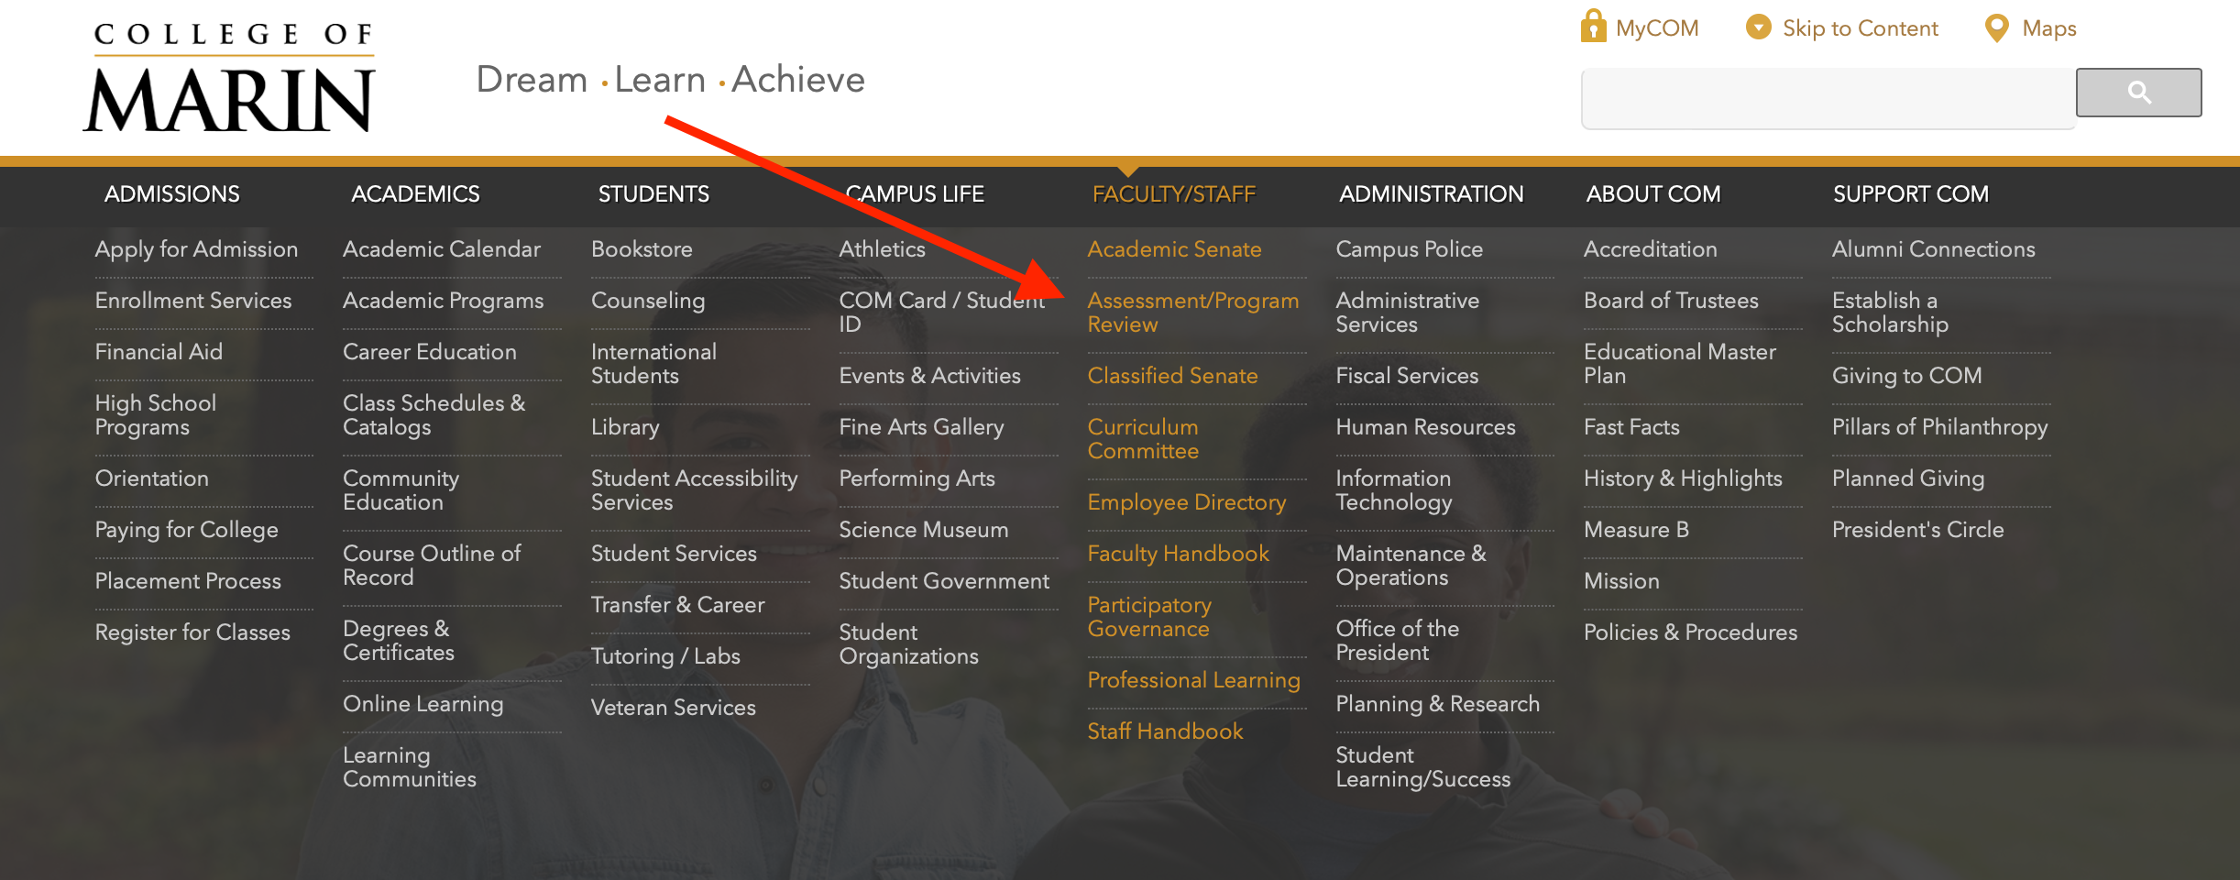
Where To Find SLOAC website

Slide 4
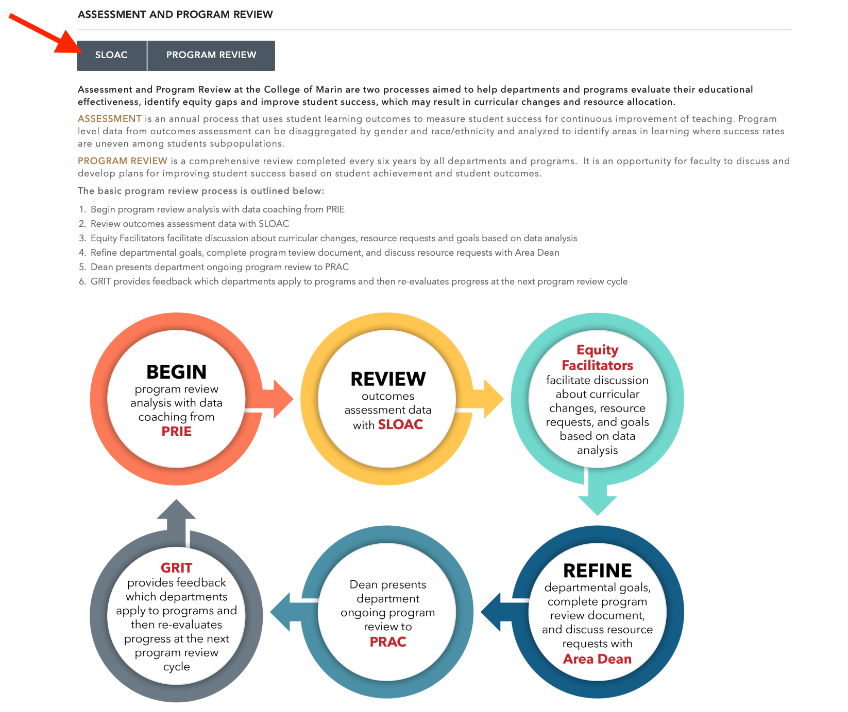

Slide 6
Where To Find Course And Program Level Outcomes
go to marin.edu then select Academics, then Course Outline of Record

Slide 7
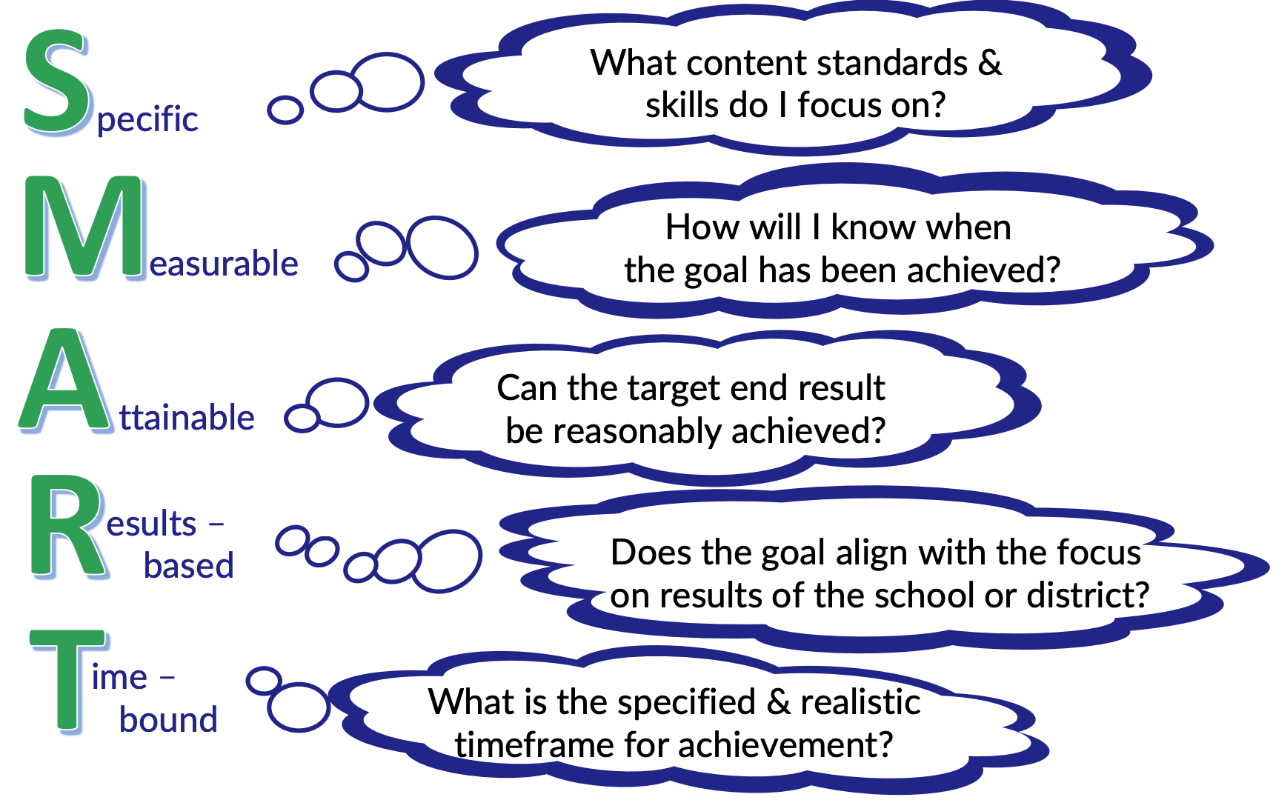
What makes a good SLO?

Slide 8
Why Does We Assess?
to improve teaching
discuss teaching strategies
identify areas where success rates are uneven among student groups
meet accreditation expectations

Slide 9
Accreditation Expectations
all courses assessed
disaggregated PSLO data is analyzed
data informs program review goals

Slide 10
Improvement Plan
Standardized approach - all courses are assessed every other year
Disaggregated reports are given to all departments at the beginning of the semester
Work with the departments to understand their data
Data helps to inform program review and show continuous improvement
The full improvement plan can be found on page 70 and 71 of the ISER

Slide 11
College Of Marin - Year 1 All Courses Assessed
1.
All school communication during fall and spring semesters
Semester ends
Assessment Coordinator
tracks progress
5.
Assessment
Year Cycle
2.
Assessment Coordinator
builds and plans
assessments
eLumen assessment
support available in
person and on zoom
4.
3.
Reminders and alerts are
emailed to faculty

Slide 12
Year 2 Assessment Data Analyzed
Departments develop data informed goals for next
assessment cycle
4.
1.
School communication at beginning of fall and spring semesters
Data Analysis
Year Cycle
SLOAC meets
with departments to
review data
3.
2.
Link to assessment
dashboard emailed to
department chair in fall

Slide 13
How has it been been working?
This past year faculty completed 93% of planned assessments
66%
94%
92%
56%

Slide 14
Types of Assessment Reports
Disaggregated reports available for race/ethnicity and gender:
ISLO - Institutional Student Learning Outcomes
PSLO - Program Student Learning Outcomes
CSLO (SLO)- course groups (3 or more sections)
Reports available for modality:
in person
hybrid
online
Reports available for time of day:
morning
afternoon
evening

Slide 15
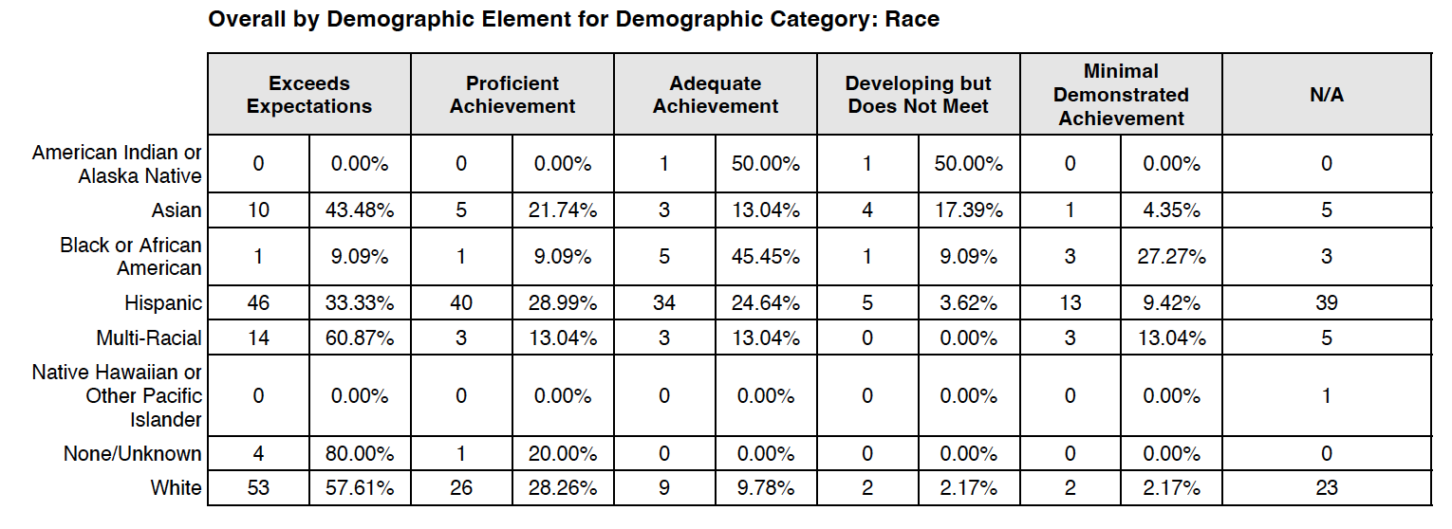
English 150 Course Group

Slide 16
Steps to building strong Program and institutional data
assess your course(s)
complete curriculum map
review assessment data and develop goal

Slide 17
Curriculum Mapping
Course Outcomes map to both Program
and Institutional Outcomes
Curriculum mapping is part of course revision
SLOAC reaches out to Chairs to complete curriculum maps
Degrees share courses from other
departments!

Slide 18
Curriculum Mapping
Course Outcomes map to both Program
and Institutional Outcomes
Curriculum mapping is part of course revision
SLOAC reaches out to Chairs to complete curriculum maps
Degrees share courses from other
departments!

Slide 19
Curriculum Mapping
Course Outcomes map to both Program
and Institutional Outcomes
Curriculum mapping is part of course revision
SLOAC reaches out to Chairs to complete curriculum maps
Degrees share courses from other
departments!

Slide 20
Curriculum Mapping
Course Outcomes map to both Program
and Institutional Outcomes
Curriculum mapping is part of course revision
SLOAC reaches out to Chairs to complete curriculum maps
Degrees share courses from other
departments!

Slide 21
Mapping considerations
When mapping SLOs, be selective.
SLOs should directly, centrally relate to a mapped PSLO.
Not all course SLOs need to map to PSLOs – Only programmatic courses.
One SLO within a programmatic course should map to at least one PSLO.
Avoid row, column, and overmapping SLO/PSLO mapping patterns.
Unmapped SLOs are possible but critically evaluate their necessity.
Ask: Which of the SLOs will be the best indicators of the PSLO?

Slide 22
Types of Assessment Reports
Disaggregated reports available for race/ethnicity and gender:
ISLO - Institutional Student Learning Outcomes
PSLO - Program Student Learning Outcomes
CSLO (SLO)- course groups (3 or more sections)
Reports available for modality:
in person
hybrid
online
Reports available for time of day:
morning
afternoon
evening

