Slide 1

Increasing Access, Equity, and Retention with Zero Textbook Cost Pathways: A CCC System-Wide Initiative
Image credit: "High school computer lab" by City of Seattle Community Tech is licensed under CC BY-NC 2.0.
Notes:
Michele

Slide 2
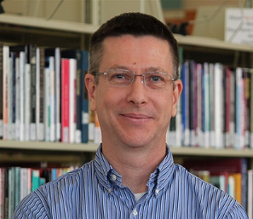

COM OER Librarians
Ron Oxford
roxford@marin.edu
Michele Alaniz
mmalaniz@marin.edu
Notes:
Michele

Slide 3
Objectives
Explain the Zero-Textbook-Cost Degree Grant (ZTC) program
Locate and evaluate OER for a variety of disciplines
Evaluate the feasibility of OER/ZTC adoption for a COM course
Notes:
Michele
Our goal today is to introduce ourselves, show you a few OER resources,

Slide 4
Definitions
Open Educational Resources (OER): Teaching, learning, and research materials that are freely available for anyone to use, adapt, and share.
Zero-Textbook Cost (ZTC): Designation for courses or programs where students are not required to purchase textbooks or pay access fee for online materials.
ZTC Degree (ZTCD): All instructional textbooks for the zero textbook cost degree program pathway must be zero-cost.
Notes:
ZTC examples include OER, eBooks or streaming videos that are free to the student but paid for by library, for instance
Michele

Slide 5

Why OER and ZTC?
Source: 2022 Student Textbook and Course Materials Survey Results and Findings at https://dlss.flvc.org/research
Notes:
Additional studies:
https://asccc-oeri.org/oer-graph-sample-course-success-rates-by-ethnicity-sacramento-city-college/
https://www.cccoer.org/case-studies/how-we-saved-students-2-million-in-4-years/
Michele

Slide 6

Zero Textbook Cost Program
Planning/Implementation Grants
Every college received a grant
Planning (June/2022)
Implementation (February/2025)
Impact Grant
Every college received a grant
(February 2025)
Adopt by Fall 2026
Notes:
Ron

Slide 7
Grant Requirements
Faculty should prioritize adapting existing OER before creating new content
All instructional materials in ZTC pathways must be zero cost to the student.
This includes required textbooks and access to any online resources or homework systems.
Ensure accessibility compliance
Notes:
Ron

Slide 8
Grant Requirements
Properly identify and apply Creative Commons (CC) licenses to OER materials
Required to report a variety of data about ZTC courses to the CCCCO
Materials produced with ZTC funding must be submitted to COOL4ED. However, the state is currently looking at a more permanent repository so this may change.
Notes:
Number of degrees developed, OER created,estimated annual student savings, and the number of students completing ZTC programs and accessing OER.

Slide 9
OER Call
Support the creation of ZTC Pathways and adoption of OER
creation of ZTC Pathway in Communication
creation of ZTC Pathways in Geography
Support GE for transfer
support Library Textbook Program (LTP) faculty in moving to OER.
.5 Units to adopt OER in a single course
1.5 Units to adapt OER in a single course
Roughly 43.7 hours of work for each unit
Notes:
Ron

Slide 10
OER Call
If no existing OER in a subject faculty can receive 3 units to create for a single course
Creation of New OER
Must be shared upon completion on COOL4ED*
Ensure ADA compliance with SAS support
Work with OER Librarians and apply Creative Commons Licenses (CC) to OER materials
Term of assignment – Fall 2025 or Spring 2026
Notes:
Ron

Slide 11
OER Call/Grant FAQ
What is required for a degree to meet the requirements? (No traditional textbooks? No fees whatsoever?)
All instructional textbooks for the zero textbook cost degree program pathway must be zero-cost. Discretionary student printing of instructional materials shall not be considered a cost as part of this program (e.g. the student chooses to print the open education resource material on their personal printer).
Notes:
From OERI or CCCCO FAQs
Ron

Slide 12
OER Call/Grant FAQ
Do materials fees for lab classes disqualify a program, and would it matter if they are actual material fees or items that must be purchased in a bookstore?
Fees for materials in certain labs are allowed. Examples: materials kits in cosmetology courses/labs or required purchase of goggles for a chemistry lab.
Notes:
Ron

Slide 13
OER Call/Grant FAQ
If a course uses a ZTC textbook but requires a student to purchase access to a homework system or other digitally accessed resource, is this a ZTC course section?
No, it is not a ZTC course section.
Notes:
Ron

Slide 14
OER Call/Grant FAQ
Exactly how many courses must be "zero-cost" with regard to the degree? For an ADT, for example, do ALL the courses a student takes for the degree (ie, 60 units across campus) need to be available at "zero-cost" or just those courses required for the degree/certificate itself (-18 units)?
All courses (major and general education) included in the zero textbook cost degree program pathway must have zero-cost textbook section options.
Notes:
Ron

Slide 15
OER Call/Grant FAQ
Exactly how many courses must be "zero-cost" with regard to the degree? For an ADT, for example, do ALL the courses a student takes for the degree (ie, 60 units across campus) need to be available at "zero-cost" or just those courses required for the degree/certificate itself (-18 units)?
All courses (major and general education) included in the zero textbook cost degree program pathway must have zero-cost textbook section options.
Notes:
Ron

Slide 16
OER Call/Grant FAQ
Does the grant require all course sections of a course be converted to utilize zero textbook cost instructional materials?
No, each program pathway course must have at least one section (major and general education) included in the zero textbook cost degree program pathway that utilizes zero textbook cost instructional material. However, colleges should be striving to maximize the number of course sections available and communicating to students how to identify ZTC course options.
Notes:
Ron

Slide 17
OER Call/Grant FAQ
If a course uses a ZTC textbook but requires a student to purchase a calculator or other instructional materials, is this a ZTC course section?
Yes. Although a ZTC section can require students to purchase supplies (other than texts and access to digital resources), colleges should have a process to inform students of these additional expenses and, if possible, establish mechanisms to reduce or remove these costs. A note in the schedule should indicate that the purchase of supplies is required. Also, systems for the loaning of some supplies can be established to assist students to reduce their costs.
Notes:
Ron

Slide 18
OER Call/Grant FAQ
If a course section does not have a required textbook (such as athletics or art course), can it count as a zero-cost textbook section for the grant?
Yes, if a course does not require a textbook, then it is ZTC qualifying by nature.
Notes:
Ron

Slide 19
Title V
Section 54221 Burden-Free Access to Instructional Materials
Governing Boards shall adopt policies that ensure student access to textbooks and supplemental materials that are needed on the first day of class.
Developing and implementing sustainable zero-textbook-cost degrees, consistent with Education Code section 78052
Notes:
https://www.cccco.edu/About-Us/News-and-Media/Press-Releases/2024-bog-adpots-groundbreaking-legislation-to-expand-free-textbooks#:~:text=%E2%80%9CThis%20regulation%20is%20a%20bold,and%20other%20institutional%20program%20resources
https://www.cccco.edu/-/media/CCCCO-Website/docs/regulatory-action/finalregtextburdenfreeaccess20250227a11y.pdf
Ron

Slide 20
Finding OER
Notes:
Ron

Slide 21

Open Education Resources Initiative (OERI)
OER by Discipline
OER by C-ID
Notes:
Ron

Slide 22

LibreTexts
Notes:
Ron
https://commons.libretext
https://commons.libretexts.org/login

Slide 23

OpenStax
Subjects including Math, Business, Nursing, Computer Science, History, Sociology, etc.
Instructor & Student Resources
Notes:
Michele PPts, test banks, and available in word format to customize textbook (although this disconnects student from auto updates)

Slide 24
+ Many More Places to Find OER
COM Library OER & ZTC Guide at https://libguides.marin.edu/oer
Reach out to your OER Librarians Ron & Michele
Notes:
Michele

Slide 25
Integrating OER into your class
Import into Canvas course
Copy/Paste to a content page
Link out from a content page
Print
Book a course design appointment with Stacey: https://tinyurl.com/StaceyLince
Available Mon, Wed, Thurs online in Teams or in-person by appointment in AC 310.
slince@marin.edu
Notes:
Michele

Slide 26
Licensing & Accessibility
Notes:
Michele

Slide 27
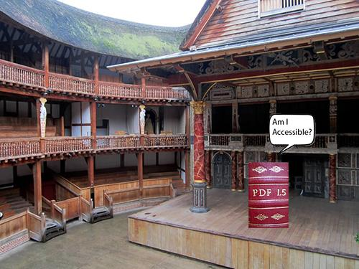
Accessibility
Student Accessibility Services (SAS)
Check accessibility
Remediate when necessary
Notes:
Michele

Slide 28
Open Licensing & Attribution
Check content for license
Common licenses include Creative Commons, GNU General Public License, MIT License
Confirm what you are allowed to do with content
Attribute
Grant requirement - OER creation
Notes:
Example: https://help.openstax.org/s/article/Commercial-use-under-the-Creative-Commons-License
Michele

Slide 29
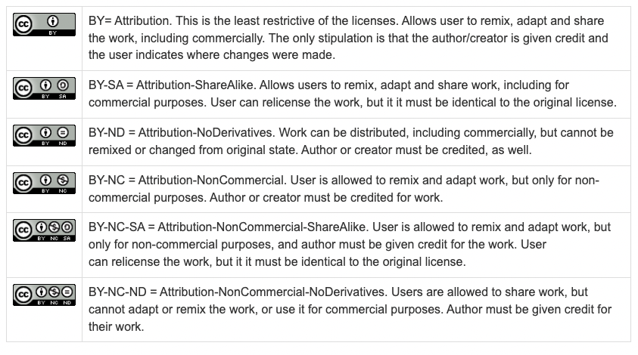
Creative Commons Licenses
Notes:
Michele

Slide 30
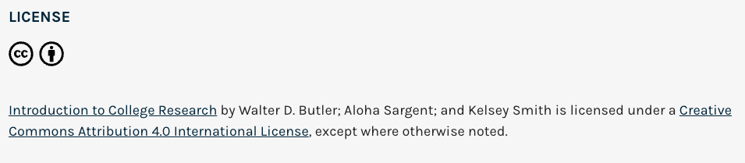
"Choosing a Library Database" by Walter D. Butler, Aloha Sargent, and Kelsey Smith is licensed under CC BY 4.0 / A derivative from the original work
Attribution Examples
Notes:
Michele

Slide 31
Bookstore & Class Schedule
Accuracy of ZTC designation in schedule
Section notes in Bookstore listing
Notes:
Michele
Go to schedule view – search by ZTC
https://www1.marin.edu/schedule

Slide 32
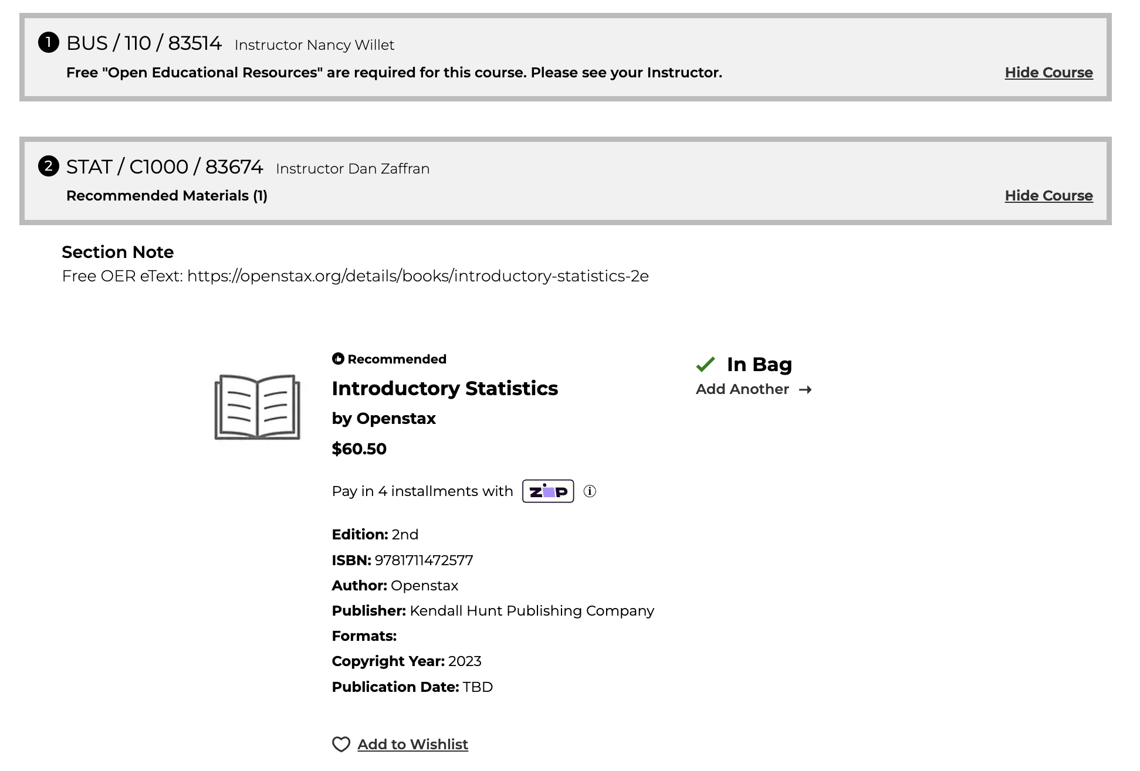
Notes:
https://openstax.org/details/books/introductory-statistics-2e
Listed in bookstore for $60, but can print from OpenStax vendor for $30 and $40. It's not clear if either is hardcover vs. Paperback
Michele

Slide 33
Activity
Search 1 source to find OER for your class (or for a class that you took and paid way too much money for the textbook)

Slide 34
Questions?
Ron Oxford
OER Librarian
roxford@marin.edu
Michele Alaniz
OER Librarian
mmalaniz@marin.edu
Ephantus Mogere
Assistive Technology Access Specialist
emogere@marin.edu
Stacey Lince
Instructional Designer
slince@marin.edu

Slide 35
Resources
COM Library OER Guide: https://libguides.marin.edu/oer
LibreTexts: https://libretexts.org/
OpenStaz https://openstax.org/
ASCCC OERI: https://asccc-oeri.org/
ASCCC OERI: Accessibility Basics https://catalog.onlinenetworkofeducators.org/courses/asccc-oeri-accessibility-basics
Notes:
ASCCC OERI: https://tinyurl.com/y38w4ctr

