Slide 1

Marin Community College District
403(b) & 457(b) Voluntary Retirement Plans
Presented by: Ryan Phillips
U.S. OMNI & TSACG Compliance Services

Slide 2
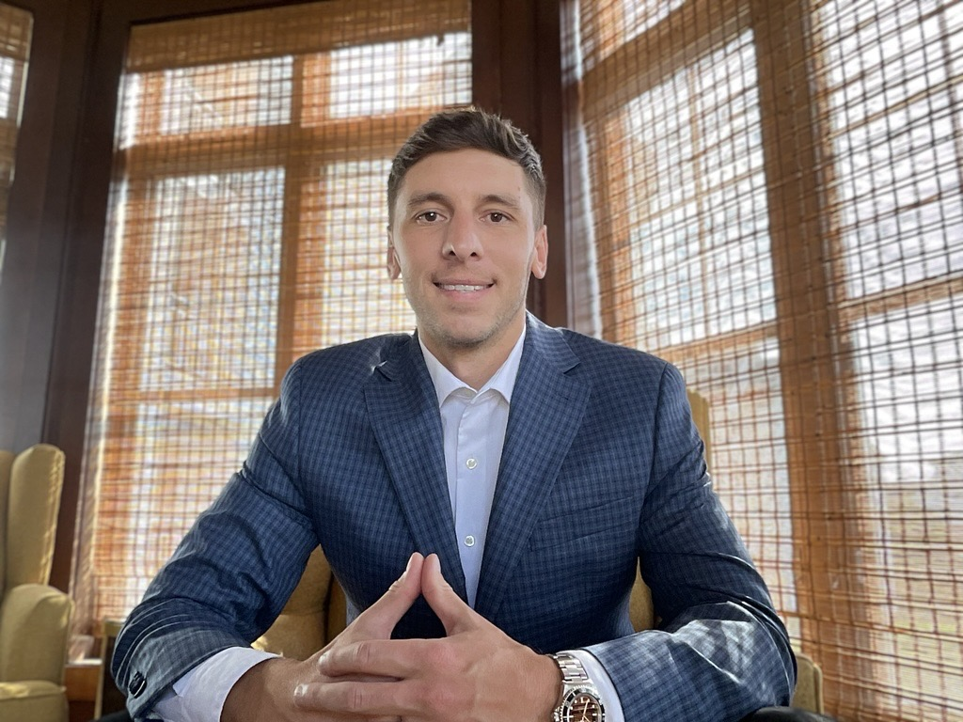
Introductions
Ryan Phillips joined USOTCS in 2017. As a Plan Consultant he is responsible for various aspects of plan administration, including client and provider relations, plan document development and maintenance, comprehensive plan evaluation, and IRS plan audit assistance. His prior employment experience was in the management consulting industry. Mr. Phillips completed his education in 2013, earning a Bachelor of Science degree in Business at the State University of New York at Brockport.

Slide 3
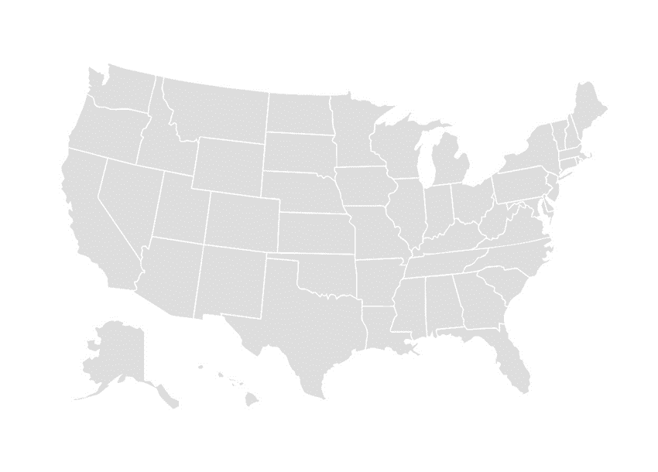
Overview: US Omni & TSA Consulting Group
Largest ‘Independent’ TPA in the Country
Plan Sponsors representing 48 states nationally.
Formerly:
US Omni
TSA Consulting Group
Administer over 8,000 plans.
8 of the 10 largest school districts in the country are clients.
3.2 million participants.
25 + years of experience.
Successfully closed more than 80 IRS audits.

Slide 4

What is a 403(b) Plan?
A 403(b) plan is a retirement plan offered by a public school for its employees.
  Accounts are funded by employees
  Elective Deferrals made under Salary Reduction Agreements
  Pre-tax or Post-tax(ROTH) contributions
  Helps supplement state pension

Slide 5
How We Help You
Starting & Changing Contributions
  Enrollment Process
  How to submit an SRA
Transaction Support & Processing
  Loans, Hardships, Rollovers, Transfers, etc.
MAC Limit Monitoring
  Maximum Allowable Contribution Limit
Assistance with Retirement
Customer Care Center for any questions about your plan

Slide 6
Why Save With 403(b)?
Future Retirement Savings Value Assuming 6% Growth
Monthly Contributions | 5 years | 15 years | 20 years
$50 | $3,489 | $14,541 | $23,102
$200 | $13,954 | $58,164 | $92,408
$500 | $34,885 | $145,409 | $231,020

Slide 7
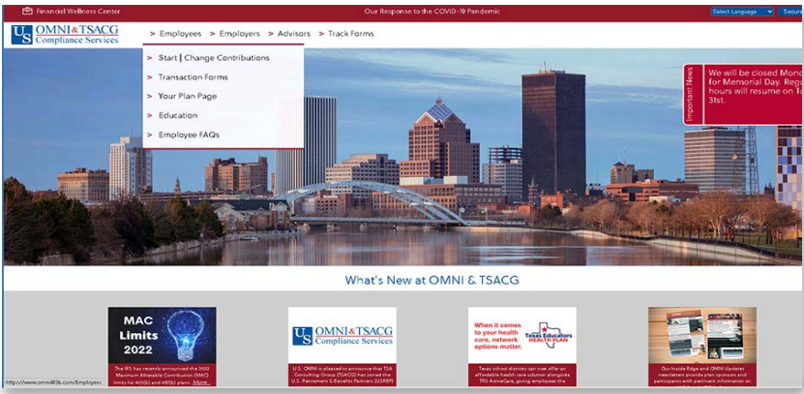
Navigating to Plan Page
www.omni403b.com

Slide 8
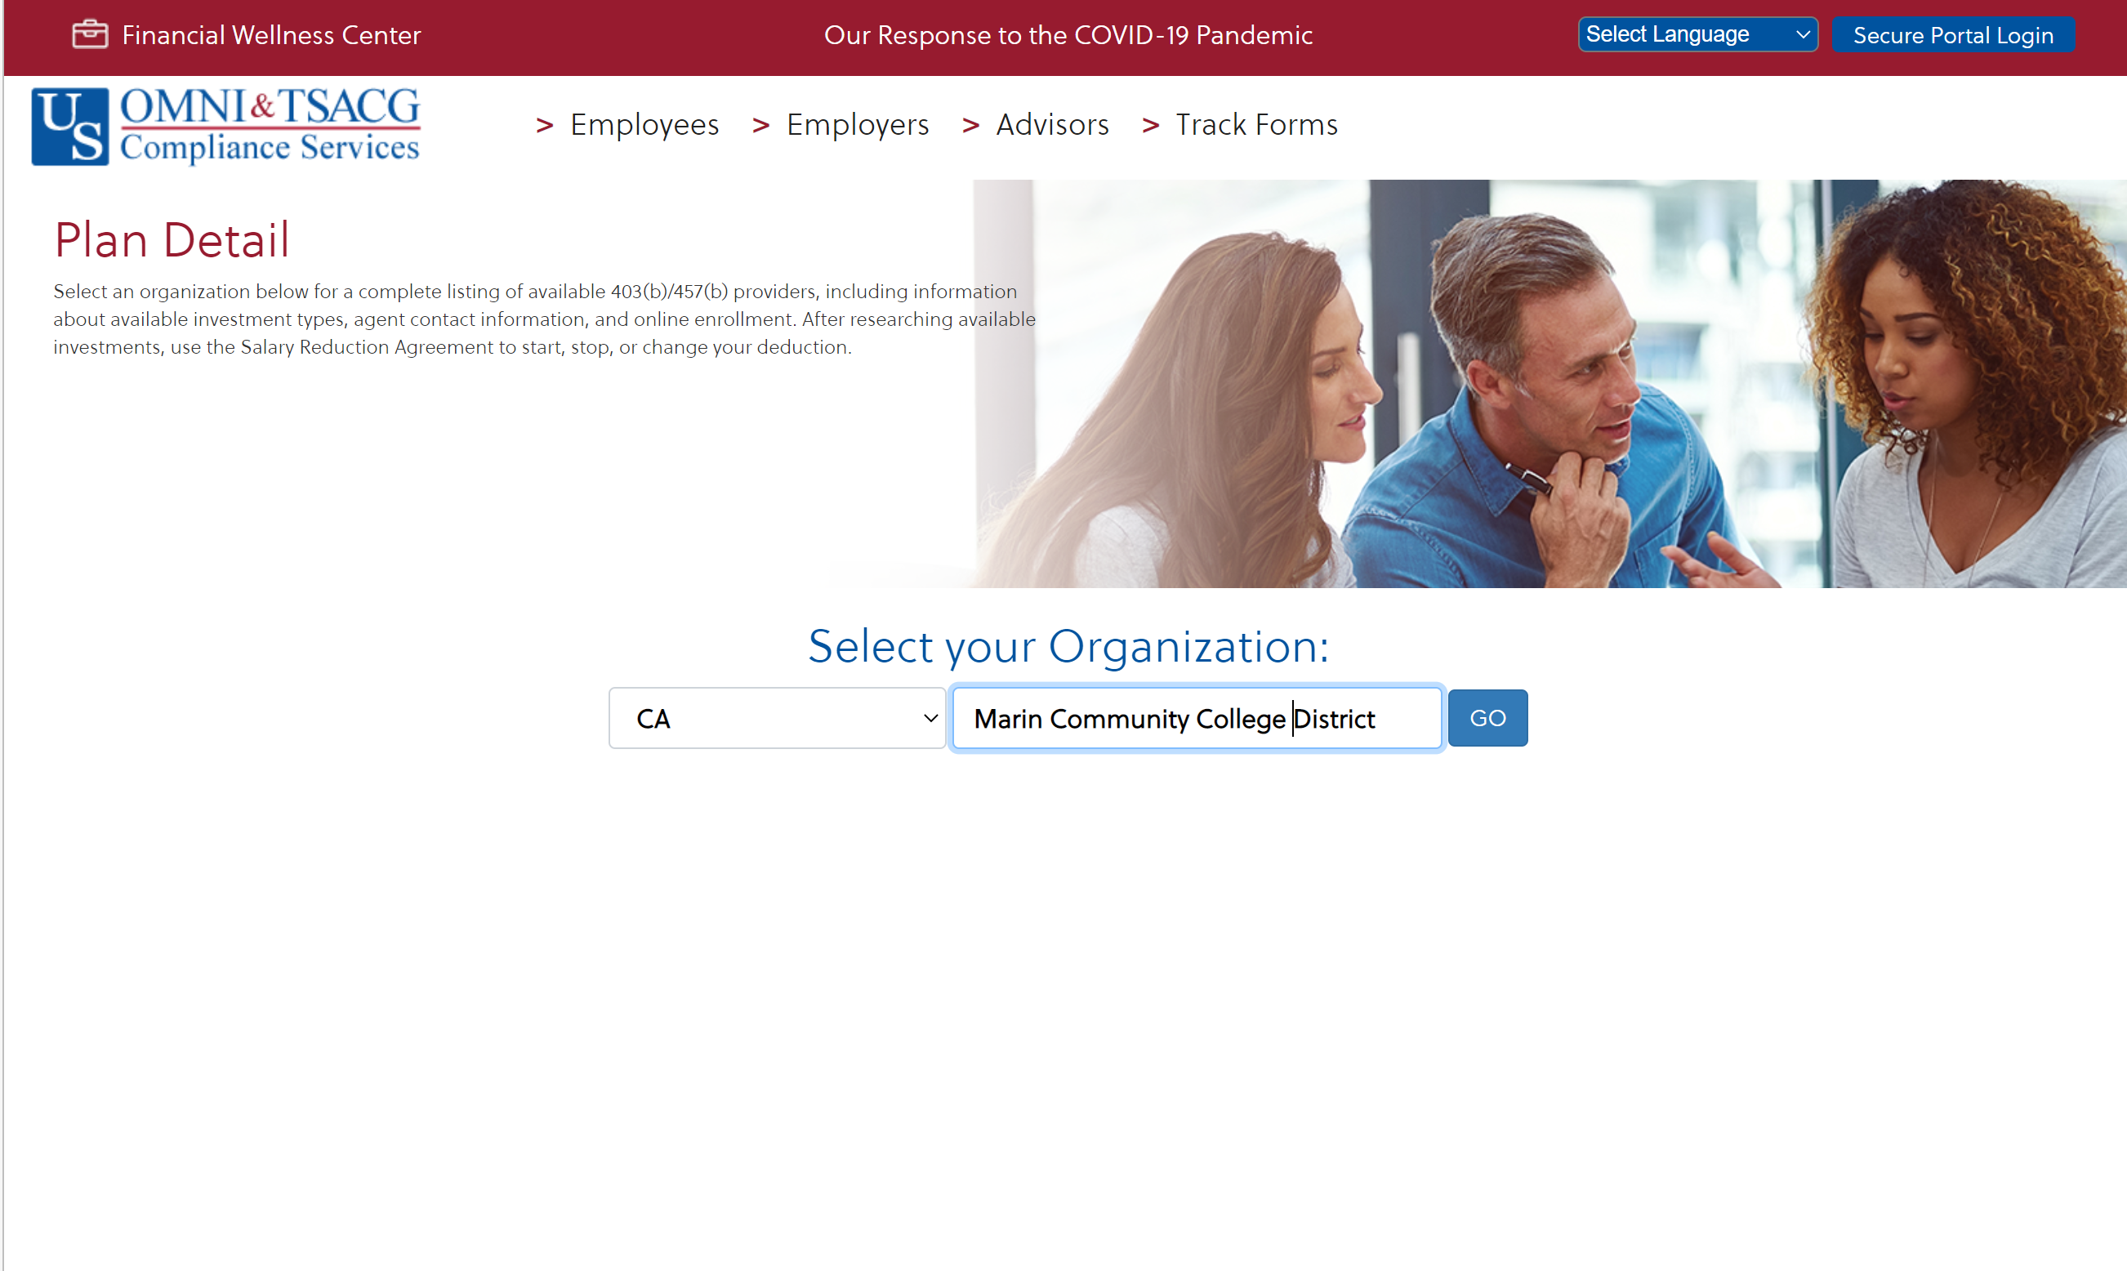
Navigating to Plan Page

Slide 9
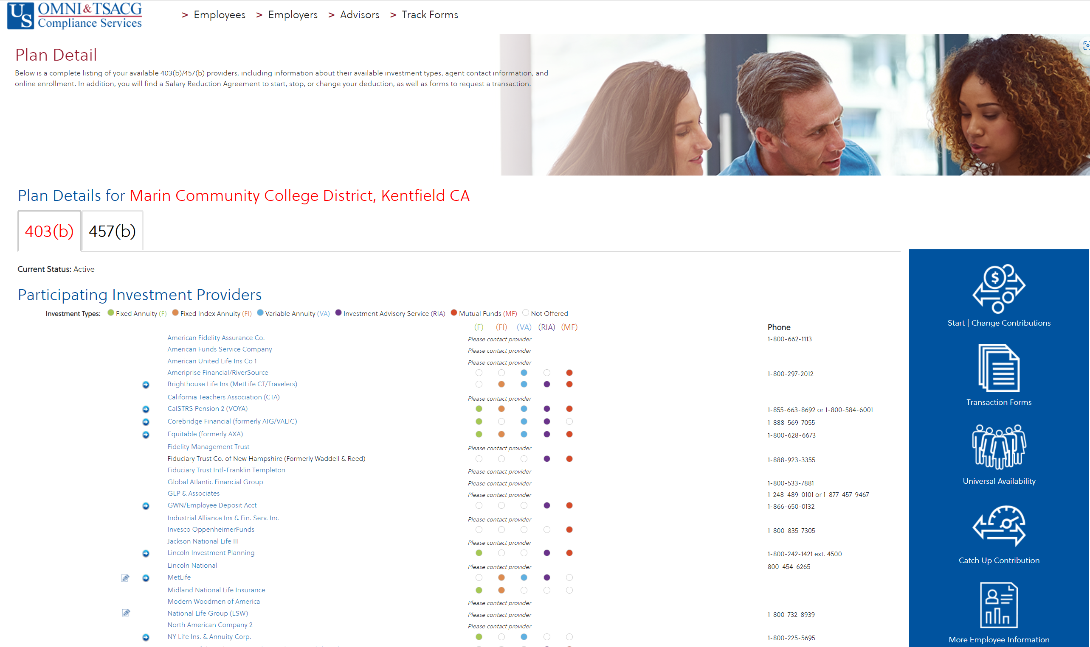
Marin Community College District Plan Page

Slide 10
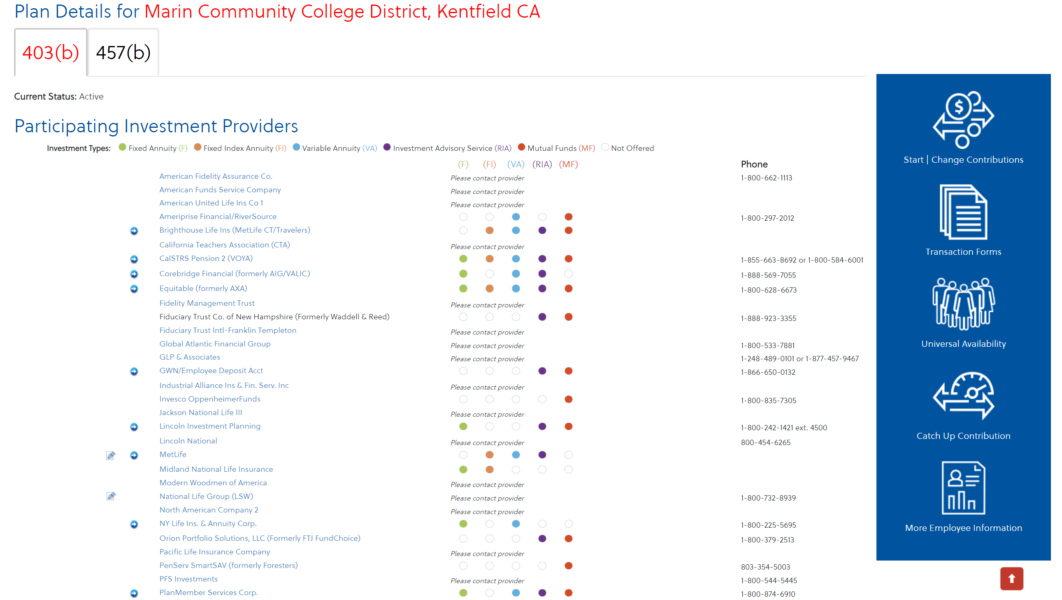
Salary Reduction Agreements (SRAs)

Slide 11
Enrollment Process
Step 1
  Review list of Authorized Investment Providers on Marin CCD plan page
Step 2*
  Open investment account with selected investment provider
Step 3
  Open the salary reduction agreement form via Marin CCD plan page
Step 4
  Follow the on-screen prompts to input all required information including “Employee Information” and “Contribution Information.”
Step 5
  Once your SRA is submitted, funds will be deducted from your next payroll and sent to your selected investment provider

Slide 12
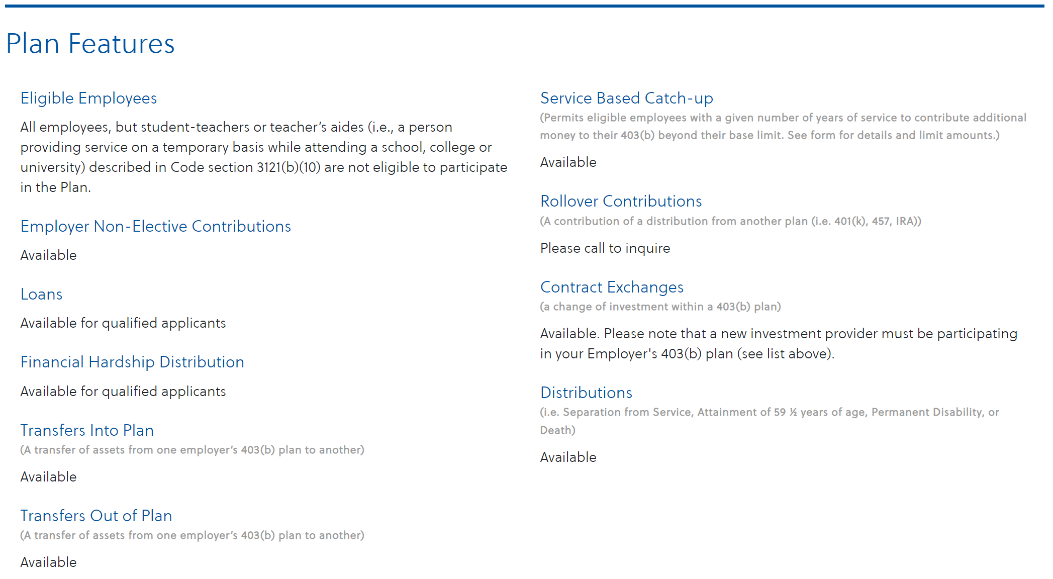
Plan Eligibility & Features

Slide 13
Transaction Support & Processing

Slide 14
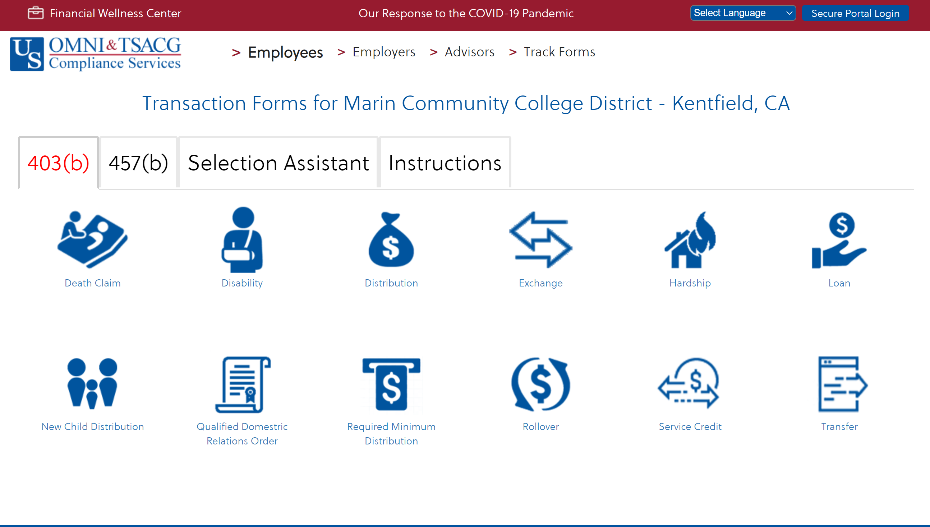
Transaction Support & Processing

Slide 15



How Much Can I Contribute to a 403(b)?
2025 Contribution Limits
$23,500 Base Limit
(402(g) Limit)
Is the employee over age 50?
YES
NO
$31,000
$23,500
Does the employee have 15 years of service with the district and a lifetime of 403(b) contribution averaging of less than $5,000?
$34,000
$31,000
$26,500
$23,500

Slide 16
Customer Care Center
Knowledgeable customer care representatives to answer any 403(b) or 457(b) related questions
877-544-6664

Slide 17
Thank you

